Slide 1
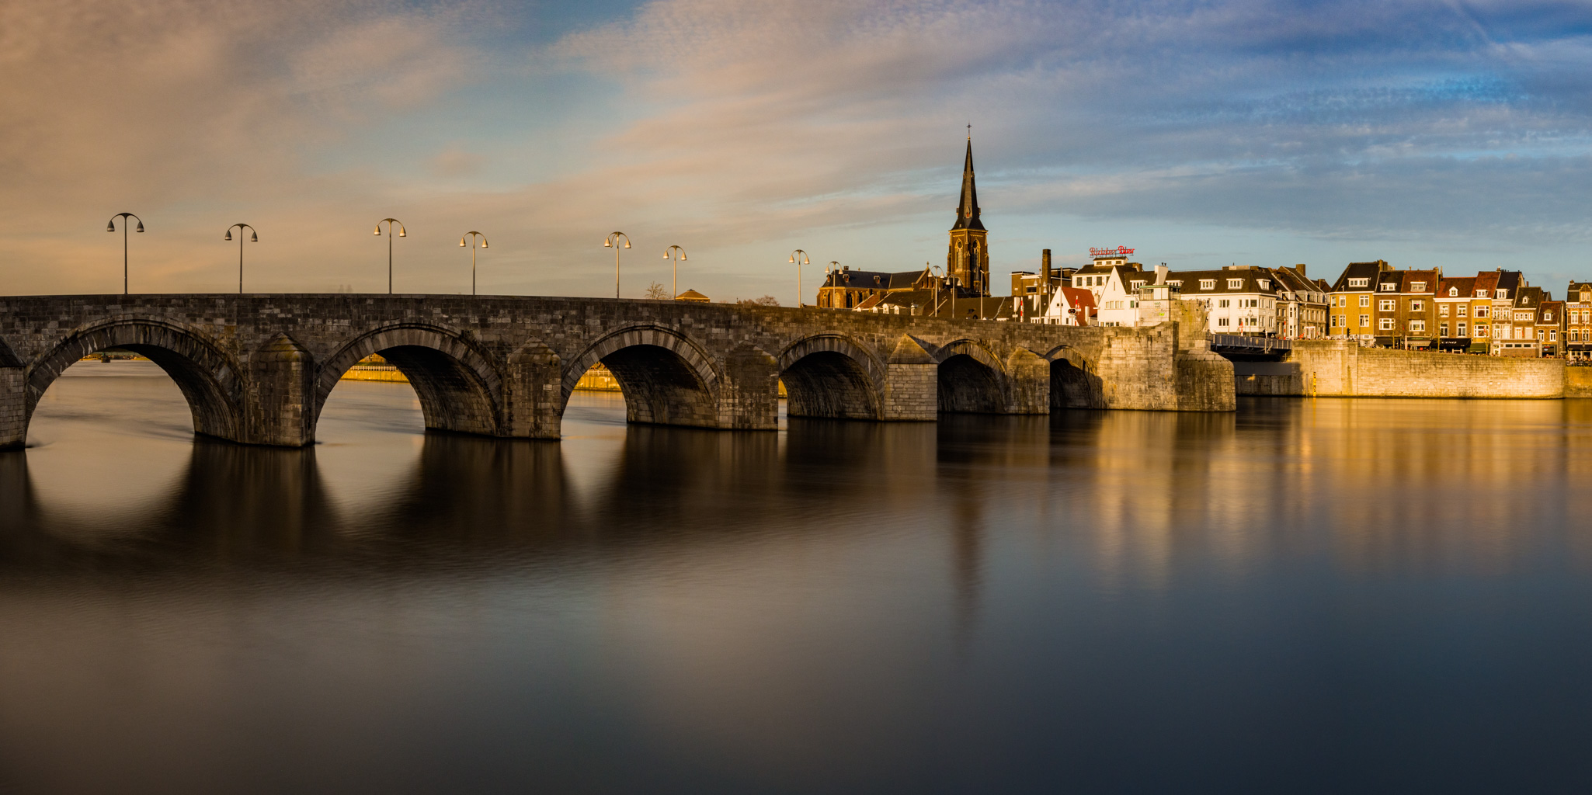


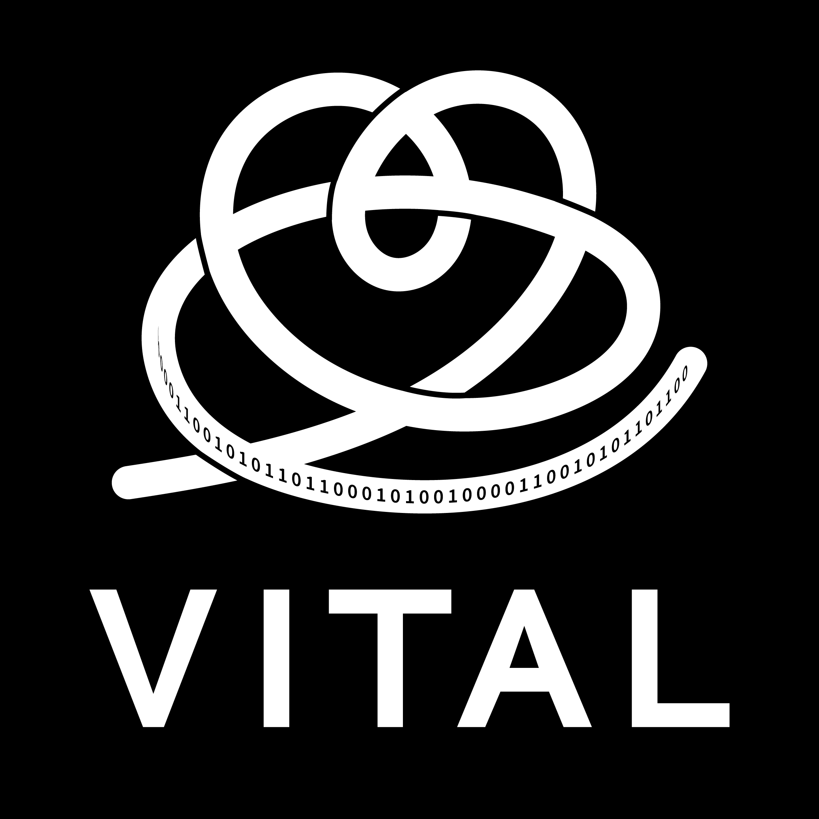
Constitutive modelling in arterial mechanics
Alessandro Giudici
Maastricht University, The Netherlands
12 February 2026, Auckland

Slide 2
Table of content:
Introduction
Thick- vs. thin-wall modelling
Experimental considerations
Viscoelasticity
Constitutive modelling in vivo

Slide 3
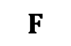
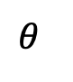
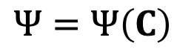
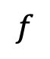
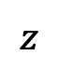
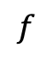
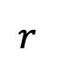

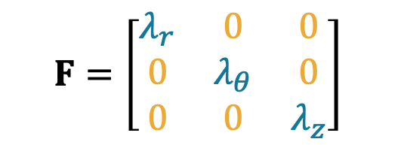
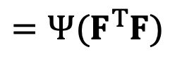
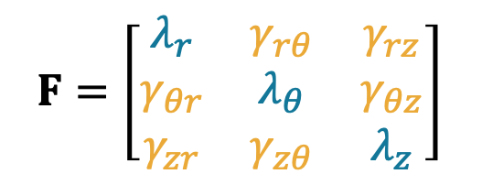
Constitutive equations: Strain energy density function
“Constitutive equation [...] is a relation between two or more physical quantities that is specific to a material […] and approximates its response to external stimuli”.
Wikipedia
$$Ψ=Ψ\left(C\right)$$
$$=Ψ(F^{T}F)$$
Strain energy density function
[Pa] = [J/m³]
Deformation gradient tensor
Right Cauchy-Green tensor
$$r$$
$$z$$
$$F$$
Orthotropic deformation
$$θ$$
$$F=\left[\begin{matrix}λ_{r} & γ_{rθ} & γ_{rz} \\ γ_{θr} & λ_{θ} & γ_{θz} \\ γ_{zr} & γ_{zθ} & λ_{z}\end{matrix}\right]$$
$$F=\left[\begin{matrix}λ_{r} & 0 & 0 \\ 0 & λ_{θ} & 0 \\ 0 & 0 & λ_{z}\end{matrix}\right]$$
$$f$$
$$f$$
$$P$$
principal directions
shear

Slide 4
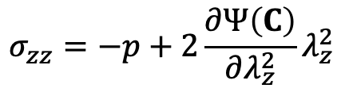
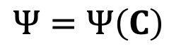
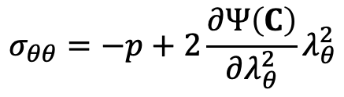
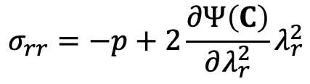
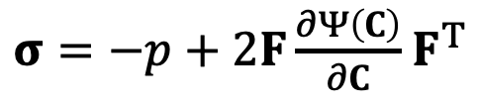
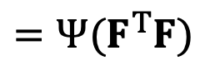
Constitutive equations: Linking energy to measurable quantities
$$Ψ=Ψ\left(C\right)$$
$$=Ψ(F^{T}F)$$
Strain energy density function
[Pa] = [J/m³]
Deformation gradient tensor
Right Cauchy-Green tensor
$$σ_{rr}=−p+2\frac{∂Ψ\left(C\right)}{∂λ_{r}^{2}}λ_{r}^{2}$$
$σ=−p+2F\frac{∂Ψ\left(C\right)}{∂C}$ $F^{T}$
$$σ_{θθ}=−p+2\frac{∂Ψ\left(C\right)}{∂λ_{θ}^{2}}λ_{θ}^{2}$$
Cauchy stress tensor
[Pa]
$$σ_{zz}=−p+2\frac{∂Ψ\left(C\right)}{∂λ_{z}^{2}}λ_{z}^{2}$$
Lagrange multiplier

Slide 5
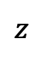
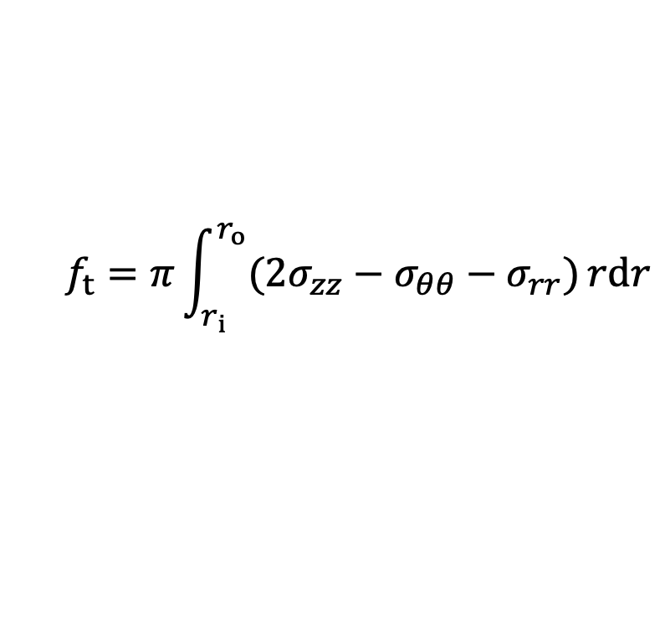
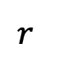
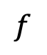
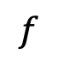
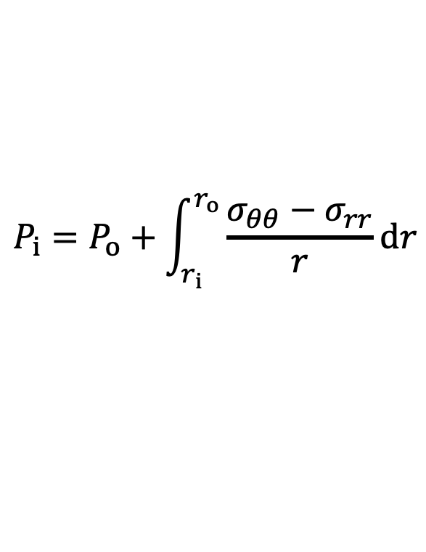

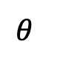
Equilibrium equations
Radial equilibrium equation:
$$r$$
0
$$P_{i}=P_{o}+\int_{r_{i}}^{r_{o}}{\frac{{σ_{θθ}−σ}_{rr}}{r}}dr$$
$$z$$
$$θ$$
$$f$$
Axial equilibrium equation:
$$P_{i}$$
$$f$$
$$f_{t}=π\int_{r_{i}}^{r_{o}}{({{2σ_{zz}−σ}_{θθ}−σ}_{rr})}rdr$$

Slide 6
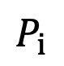
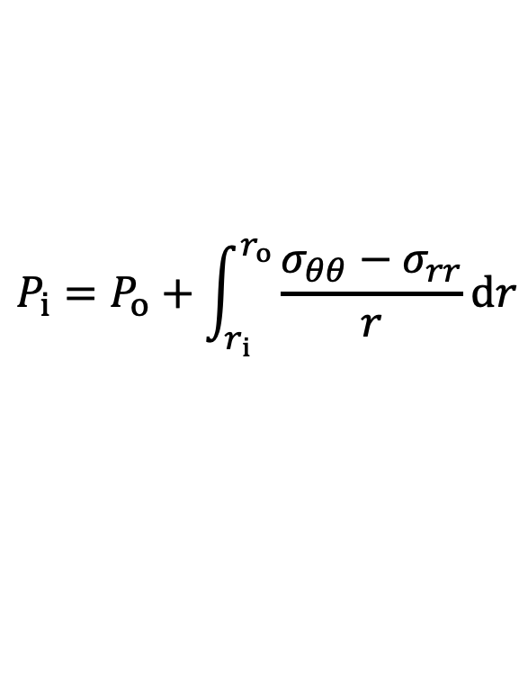
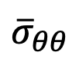
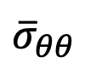
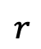
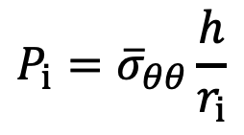
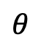
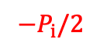
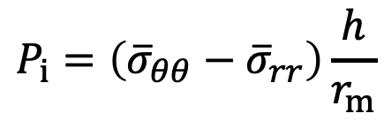
Equilibrium equations: Radial equilibrium
0
Thin wall
$$−P_{i}/2$$
$$P_{i}=P_{o}+\int_{r_{i}}^{r_{o}}{\frac{{σ_{θθ}−σ}_{rr}}{r}}dr$$
$$P_{i}=\left({\overline{σ}}_{θθ}−{\overline{σ}}_{rr}\right)\frac{h}{r_{m}}$$
$$P_{i}={\overline{σ}}_{θθ}\frac{h}{r_{i}}$$
Laplace’s law
$$r$$
$$θ$$
$$P_{i}$$
$${\overline{\text{σ}}}_{θθ}$$
$${\overline{\text{σ}}}_{θθ}$$
$$P_{i}$$

Slide 7
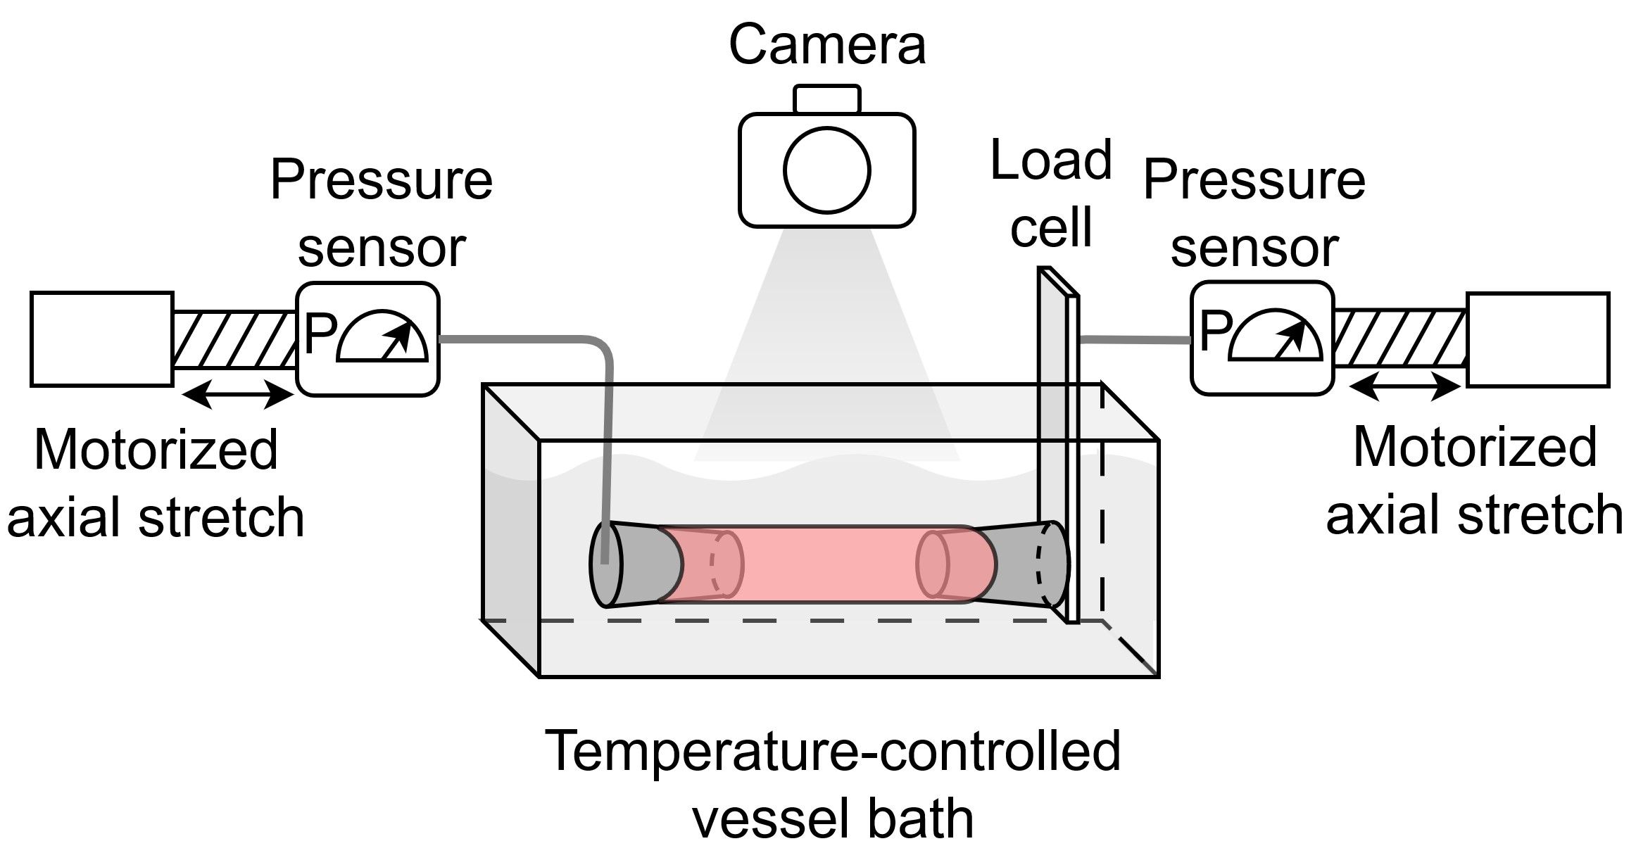
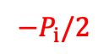
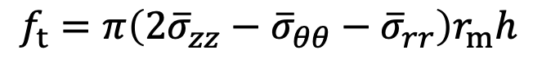
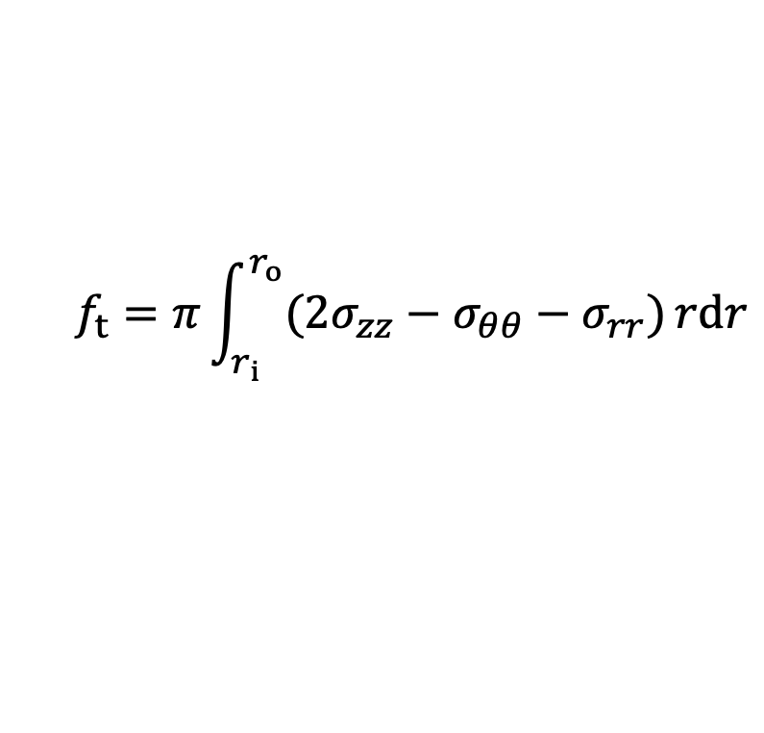
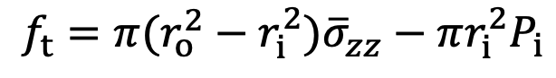

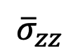
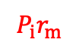
Equilibrium equations: Axial equilibrium
Thin wall
$$−P_{i}/2$$
$$P_{i}r_{m}$$
$$f_{t}=π\int_{r_{i}}^{r_{o}}{({{2σ_{zz}−σ}_{θθ}−σ}_{rr})}rdr$$
$$f_{t}=π\left(2{\overline{σ}}_{zz}−{\overline{σ}}_{θθ}−{\overline{σ}}_{rr}+{\overline{σ}}_{rr}−{\overline{σ}}_{rr}\right)r_{m}h$$
$$f_{t}=2π\left({\overline{σ}}_{zz}−{\overline{σ}}_{rr}\right)r_{m}h−π({\overline{σ}}_{θθ}−{\overline{σ}}_{rr}){h r}_{m}$$
$$f_{t}=π\left(2{\overline{σ}}_{zz}−{\overline{σ}}_{θθ}−{\overline{σ}}_{rr}\right)r_{m}h$$
$$f_{t}=π(r_{o}^{2}−r_{i}^{2}){\overline{σ}}_{zz}−πr_{i}^{2}P_{i}$$
$${\overline{σ}}_{zz}$$
$$P_{i}$$
$$r$$
$$z$$
$$θ$$

Slide 8
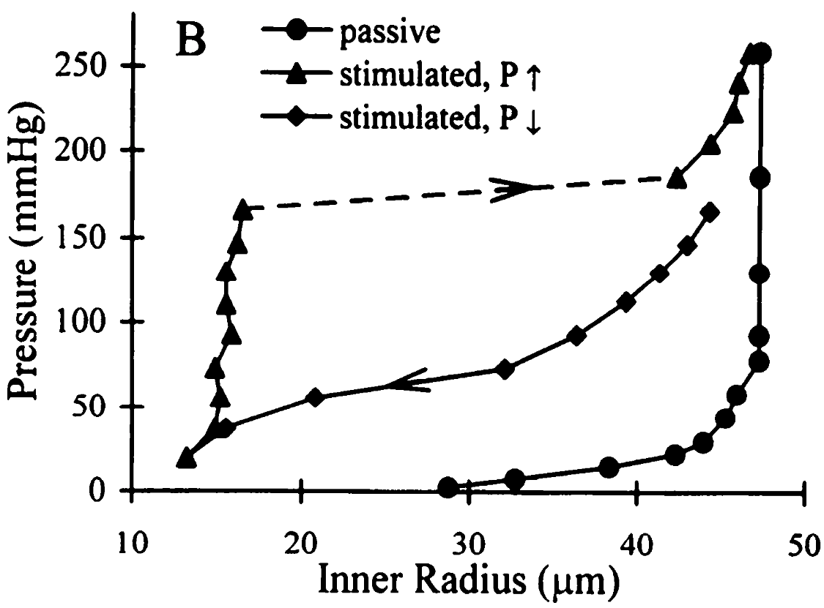
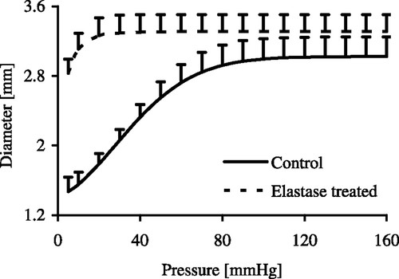
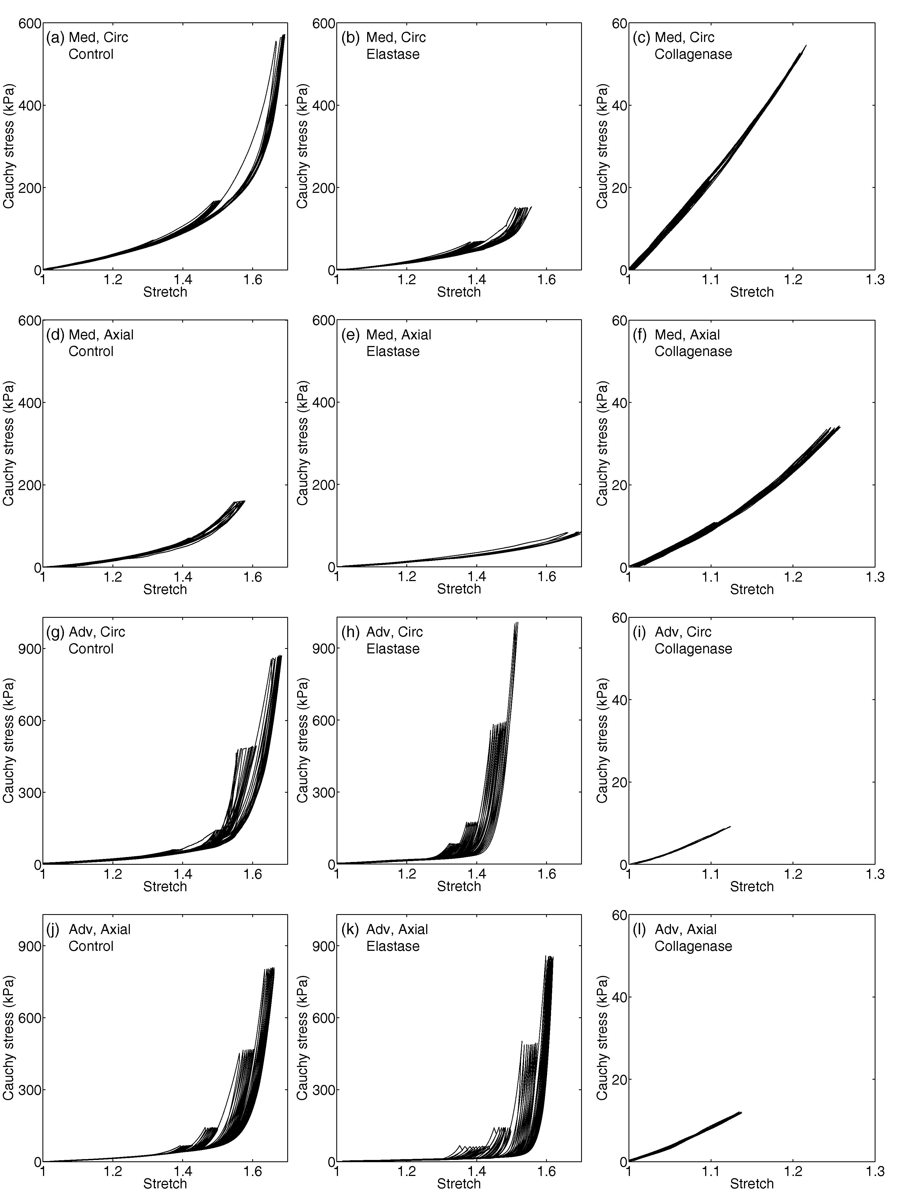
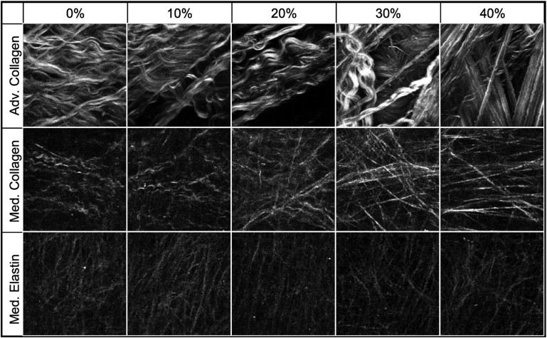
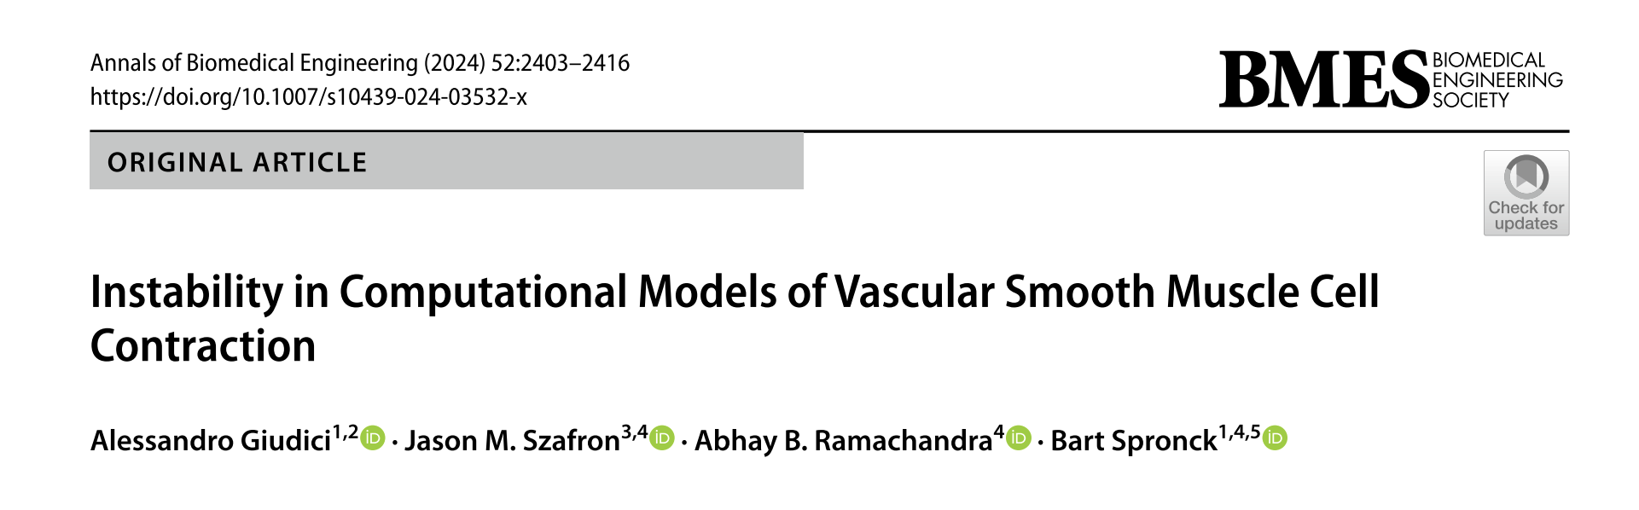

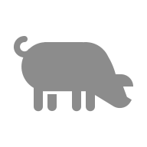

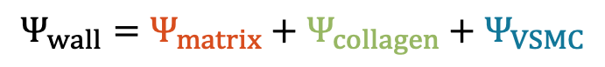
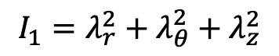
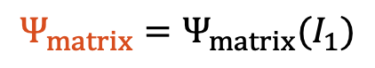



What constitutive equations to use? – Pressure
elastin
Arterial wall tissue model
Pressure
Diameter
vascular smooth muscle cells (VSMCs)
matrix
(elastin)
collagen
VSMCs
collagen
$$Ψ_{wall}=Ψ_{matrix}+Ψ_{collagen}+Ψ_{VSMC}$$
Quick, Am J Physiol Heart Circ Physiol, 1996, 271(6): H2669-76.
$$Ψ_{VSMC}=Ψ_{VSMC}(λ_{θ})$$
$$Ψ_{collagen}=Ψ_{collagen}(I_{4,}I_{1})$$
$$Ψ_{matrix}=Ψ_{matrix}(I_{1})$$
$$I_{4}=λ_{θ}^{2}\sin^{2}\left(α\right)+λ_{z}^{2}\cos^{2}(α)$$
Schriefl, Acta Biomater 2015; 17: 125-36.
$$I_{1}=λ_{r}^{2}+λ_{θ}^{2}+λ_{z}^{2}$$
Fonck, Am J Physiol J 2007; 292(6): H2754-63.
Chow, Biophysical J 2014; 106(12): 2684-92.

Slide 9




What constitutive equations to use? – Transducer force
Isobaric transducer force–length relationships
Aorta
Femoral artery
Carotid artery
Force [10³ dynes]
Force [10³ dynes]
Force [10³ dynes]
Length [cm]
in vivo
axial length
Length [cm]
Length [cm]
van Loon, Biorehology 1977; 14(4): 181-201

Slide 10


What constitutive equations to use? – In vivo axial stretch
carotid

Slide 11



Parametrisation
aorta
Circ. stress [MPa]
Axial stress [MPa]
Axial stretch [-]
Circ. stretch [-]
Axial stretch [-]
Circ. stretch [-]

Slide 12
Table of content:
Introduction
Thick- vs. thin-wall modelling
Experimental considerations
Viscoelasticity
Constitutive modelling in vivo

Slide 13










Thick- vs Thin-walled modelling
Thin-wall modelling assumptions:
wall thickness $≪$ radius: $r_{i}≅r_{o}≅r_{m}$
uniform stresses: $σ\left(r\right)=\overline{σ}$
$$F$$
$$P$$
$$λ_{θ}$$
$$F_{2}$$
$$r_{i}$$
$$r$$
$$r_{o}$$

Slide 14

Tri-layered arterial wall structure

Slide 15


Tri-layered arterial wall structure
aorta
Ascending aorta
Wall
Intima
Media
Adventitia
Descending thoracic aorta
Ascending aorta
Wall
Intima
Media
Adventitia
Descending thoracic aorta
Giudici, J Biomech Behav Biomed Mater 2023; 141: 105752

Slide 16




Hybrid solution: Tri-layered thin-walled model
Intima constitutive model
Tri-layered constitutive model
A multi-scale computational model which simultaneously recapitulates:
Major constituents within each arterial layer
The three arterial layers individually
The whole-organ mechanics of the artery
Tri-layered constitutive model
High number of unknown parameters
Assembly
Layers
Model parameters
Media constitutive model
Overfitting
Unless assumptions are made on some parameters based on microscopy or literature data:
Wang et al. 2016, J Biomech, 49:2358-2365
Polzer et al. 2015, Acta Biomater, 14:133-145
Fata et al. 2014, J Biomech Eng, 136(2): 021009
Adventitia constitutive model
Giudici, Ann Biomed Eng 2021, 49:2454-2467.

Slide 17

Hybrid solution: Tri-layered thin-walled model
aorta
Intimal matrix
Intimal collagen
Medial matrix
Medial collagen
Adventitial matrix
Adventitia collagen
Giudici, Ann Biomed Eng 2021, 49:2454-2467.

Slide 18

Functional uniqueness of the ascending aorta
aorta
Relative change in stored elastic energy over a 40 mmHg pressurisation [%]
Giudici, J Mech Behav Biomed Mater 2023, 141:105752.

